Slide 1
JustDice
Ahmed Ismail Abozeid

Slide 2
Introduction
I conducted a thorough analysis of JustDice's data to provide valuable insights into the company's performance and opportunities for improvement. Our findings cover a range of topics, including revenue, installations, countries, apps, and more. In this presentation, we will present our data-driven insights, hypothesis testing, and recommendations to help JustDice optimize its operations and grow its business. Let's dive in and discover the potential for Just Dice.

Slide 3
Data Analysis
I used python with pandas , Seaborn , Matplotlyb and other data analysis libraries for datasets preprocessing and data analysis and visualizations.
Let’s dive into some of our interesting insights :
-for more info…List location or contact for specification (or other related documents)

Slide 4
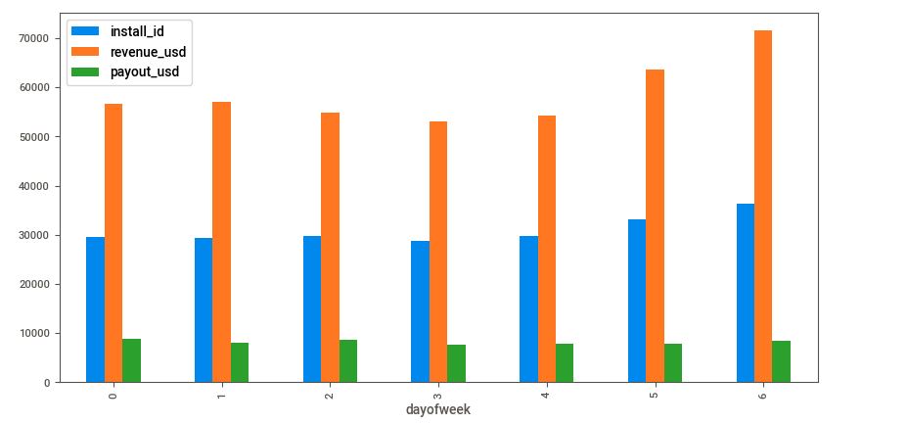
Data Analysis and Insights
Weekend Days Have the Highest Number of Installs, Revenue, and Payout: The analysis shows that Saturday and Sunday are the days with the highest number of installs, revenue, and payout. On the other hand, Thursday has the lowest number of installs, revenue, and payout.

Slide 5
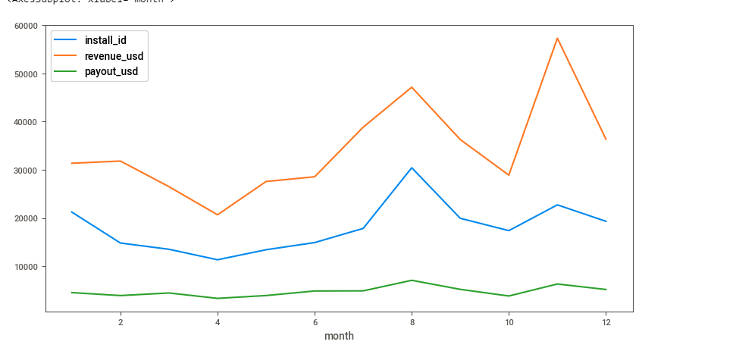
Data Analysis and Insights
Seasonal Trends in Revenue , Installs and Payout: The data visualization shows a seasonal positive trend in revenue during November , August and a seasonal negative trend in April, November, and December. There are a seasonal positive trend in August for number of installs . Things in payout is nearly stable without any sudden trends 2022

Slide 6
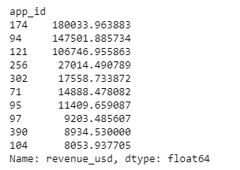
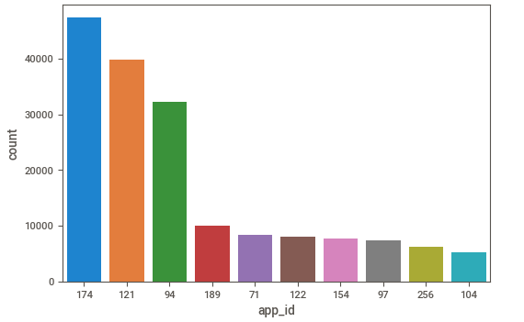
Data Analysis and Insights
Apps Analysis: The data analysis shows that apps with ID number 174, 94, and 121 are the most profitable apps with big revenue differences from other apps. The same apps also have the highest number of installs.

Slide 7
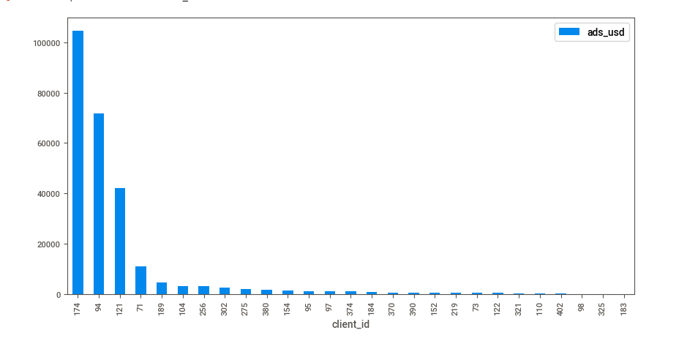
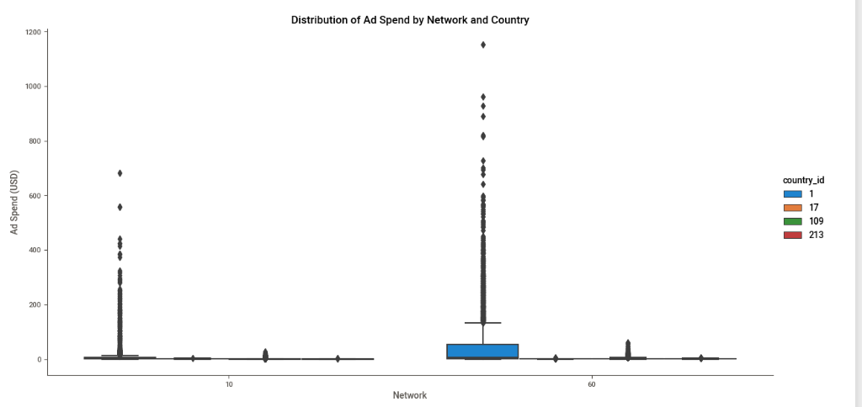
Data Analysis and Insights
Ad Spending Analysis: The data analysis shows that clients with ID number 174, 94, and 121 have the highest number of ad spending. Additionally, network 10 and 60, and country 1 and 109 have the most ad spending.

Slide 8
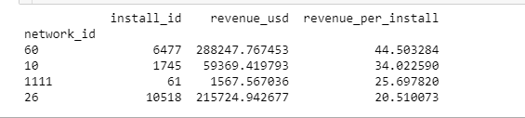
Data Analysis and Insights
Networks Analysis: Network 60 has the highest revenue per install with 44.50 USD, while Network 26 has the highest number of installs with a total revenue of 215,724 USD and a revenue per install of 20.51

Slide 9
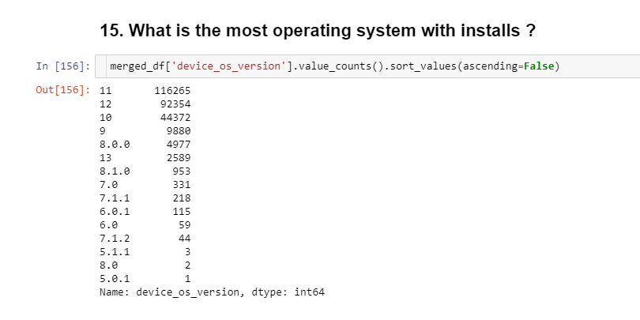
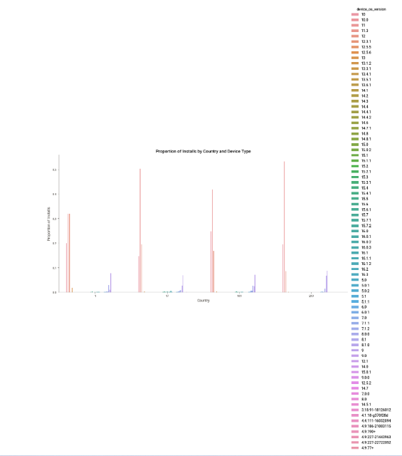
Data Analysis and Insights
Operating system Analysis: The analysis shows that the most popular operating systems are 11 and 12, which have the highest number of installs, revenue, and payout. The majority of JustDice's users in four different countries use OS versions between 10 and 12.

Slide 10
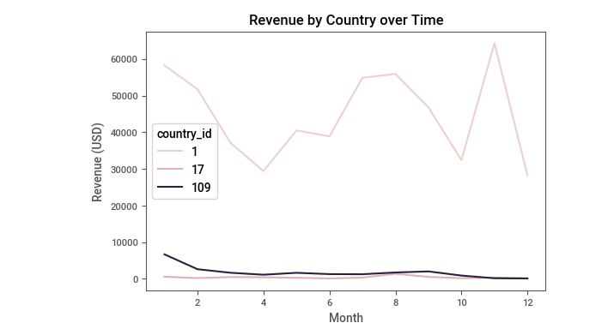
Data Analysis and Insights
Countries analysis: The analysis shows that country 1 has the highest number of installations, revenue, and payout. It also shows a negative trend in December

Slide 11
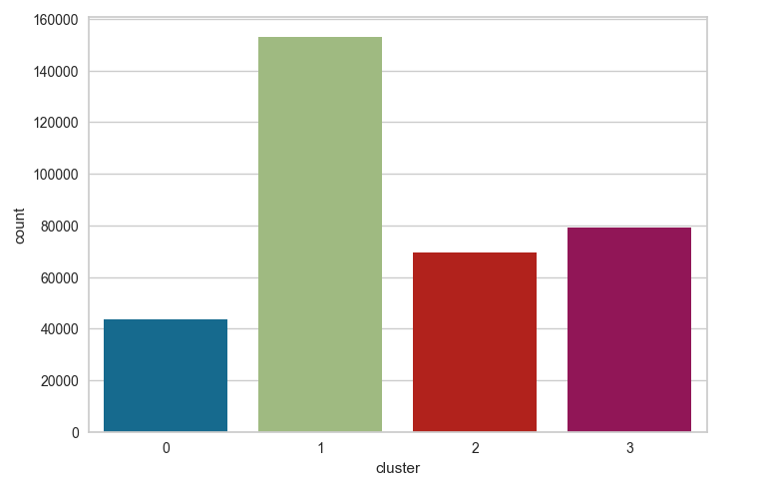
Data Analysis and Machine learning
Customers segments: We used unsupervised machine learning to cluster our users to four segments depending on the revenue to understand our customers more

Slide 12
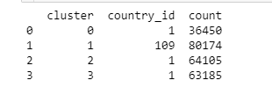
Data Analysis and Machine learning
Customer Segmentation by Country: All customer segments have more customers with country_id 1 except for the second segment, which has more users with country_id 109

Slide 13
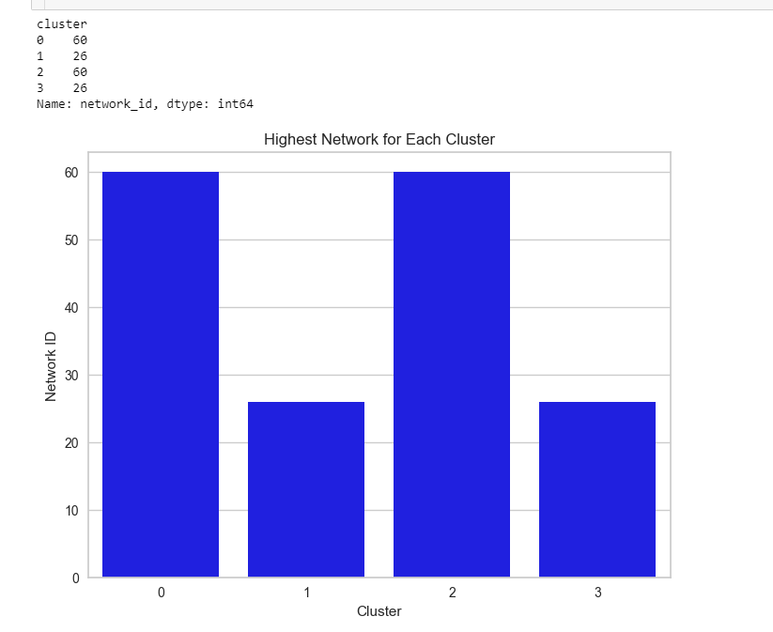
Data Analysis and Machine learning
network installation patterns for each cluster: Clusters 0 and 2 both install more using network ID 60, while clusters 1 and 3 both install more using network ID 26

Slide 14
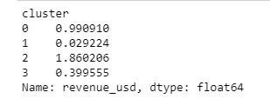
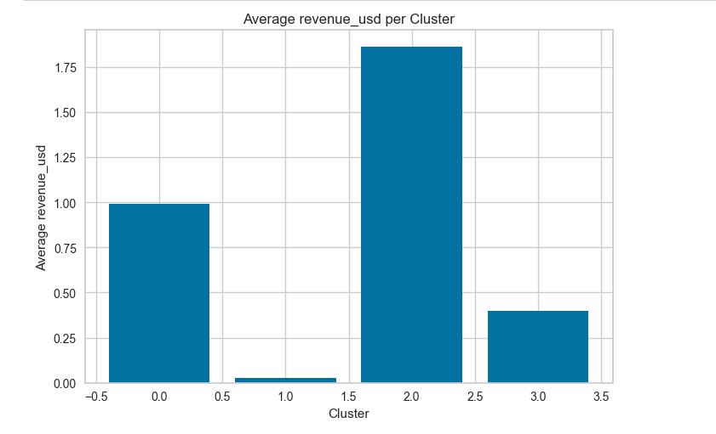
Data Analysis and Machine learning
Revenue per User by Cluster: Cluster 2 has the highest revenue per user and cluster 1 has the lowest revenue per user

Slide 15
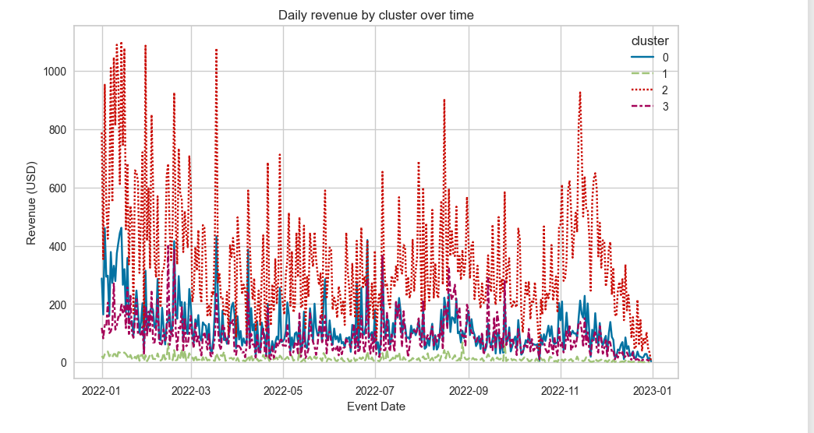
Data Analysis and Machine learning
Revenue Trends by Segments: Our second segment of users is steady without any trends all over the year and with the lowest revenue all over the year. Our first and fourth segments have nearly the same trends all over the year with near revenues except some months our first cluster has scored higher revenue than the fourth segment. Our third segment is the segment with the most revenue and with the biggest trends all over the year with big different than other segments.

Slide 16
Recommendations :-
Weekends are the best days for JustDice, with the highest number of installs, revenue, and payouts. In contrast, Thursdays have the lowest number of installs, revenue, and payouts. This suggests that JustDice may want to focus its marketing efforts more heavily on weekends to maximize its impact.
The company may want to adjust its strategies accordingly during the months with positive trends and negative trends.
August is a good month for the apps in terms of installations, with a seasonal positive trend. This may present an opportunity for the company to increase its marketing efforts during this month.

Slide 17
Recommendations :-
Apps with high installation counts tend to have higher revenue, with the three highest-installation apps generating over $40,000 each in revenue. This suggests that JustDice may want to focus on apps with high installation counts to maximize its revenue potential.
The majority of JustDice's users in four different countries use OS versions between 10 and 12. This may be helpful information for developers working on future versions of JustDice's apps.
JustDice's ad spending is highest on Network 10 and 60, and Country 1 and 109. This may suggest that the marketing team is targeting specific markets with its advertising efforts.

Slide 18
Recommendations :-
Network 60 has the highest revenue per install, with $44.50, while Network 26 has the highest number of installations, with 10,518. This suggests that the marketing team may want to focus its advertising efforts on Network 60 to maximize revenue potential.
Country 1 also has the highest revenue and payout all year round, although it experiences an unusual negative trend in December. This may suggest that the company should adjust its strategies during this month to maintain revenue and payouts.
Apps with ID numbers 174, 94, and 121 generate the most revenue, with a significant difference from other apps. This indicates that these apps may be particularly valuable to JustDice's success.

Slide 19
Recommendations :-
Focus on expanding in country_id 1, as this country has the largest number of customers across all segments.
Consider investing in network ID 60, as it is the top-performing network for both cluster 0 and cluster 2, which are two of the higher-performing customer segments.
Allocate more resources to improving revenue generation for cluster 1, as this segment has the lowest revenue per user and is performing the least well among the four clusters.
Explore ways to increase the number of installs for cluster 1, which has the lowest installs to payouts ratio. This could potentially be done by targeting this segment with more marketing or promotional activities.

Slide 20
Recommendations :-
Consider optimizing the company's offerings for customers using a specific operating systems, as there is a significant association between operating system and customer segments.
Analyze the trends and revenue patterns for each customer segment by month and day, and adjust the company's strategies accordingly. For example, cluster 3 generates the most revenue and has the biggest trends all over the year, so it might make sense to focus more on this segment and adjust strategies to further boost revenue.

Slide 21
Conclusion
Based on the data analysis and hypothesis testing performed, several key findings and insights have been uncovered.
Firstly, the majority of JustDice's revenue comes from only one country which is country with id 1. This suggests that JustDice could potentially focus more of their marketing efforts in these countries to increase revenue.
Secondly, the performance of certain advertising networks varies widely, with some networks generating much higher revenue per user than others. JustDice should consider reallocating advertising spending to focus on the networks that are most effective at generating revenue.
Thirdly, the results of the hypothesis testing suggest that there is a significant difference in revenue generated between users who have made a purchase and those who have not. This underscores the importance of developing effective monetization strategies to encourage more users to make purchases.
Based on these findings, it is recommended that the company focus on targeted marketing efforts in the most profitable countries and invest more in advertising networks that have shown to be effective at generating revenue. Additionally, efforts should be made to improve monetization strategies to encourage more users to make purchases.
Overall, implementing these recommendations has the potential to significantly increase revenue for the company and drive growth in the long term.

